Slide 1
DHARANIDHARAN P
Final Project

Slide 2
PROJECT TITLE
TRAFFIC SIGN CLASSIFICATION

Slide 3


AGENDA
Data Collection and Preparation
Model Selection and Architecture Design
Model Training
Model Evaluation and Optimization
Deployment and Integration
3/21/2024 Annual Review

Slide 4

PROBLEM STATEMENT
Develop an accurate and efficient system for classifying traffic signs based on images. Given a dataset of traffic sign images, build a Convolutional Neural Network (CNN) model that can recognize and classify various traffic signs commonly found on roads and highways. The goal is to enhance road safety by automating the process of identifying signs, which is crucial for self-driving cars, navigation systems, and traffic management.

Slide 5

PROJECT OVERVIEW
Objective: Develop a CNN-based system to accurately classify traffic signs from images, vital for self-driving cars and navigation systems, enhancing road safety.
Key Components: Data collection and preprocessing, model development with optimized CNN architecture, training, and evaluation using split datasets, testing on unseen data, deployment into real-world applications, integration with target platforms, and ongoing monitoring and maintenance.
Expected Outcomes: A robust and efficient system capable of real-time traffic sign classification, improving navigation accuracy and overall road safety.

Slide 6

WHO ARE THE END USERS?
Drivers: Ordinary motorists rely on navigation systems with traffic sign classification for safer and more informed driving.
Autonomous Vehicle Developers: Engineers developing self-driving cars depend on accurate traffic sign classification for vehicle navigation and safety.
Navigation App Users: People using navigation apps benefit from traffic sign classification for better route guidance and awareness.
Traffic Management Authorities: Agencies use traffic sign classification to monitor roads, enforce regulations, and improve traffic flow.
Urban Planners: City planners utilize traffic sign classification data to inform decisions about road infrastructure and traffic management for safer cities.

Slide 7

YOUR SOLUTION AND ITS VALUE PROPOSITION
Our solution is a precise traffic sign classification system using advanced CNN technology, ensuring accurate sign recognition for safer driving. It seamlessly integrates into existing navigation systems, offering efficient route planning and guidance while minimizing costs. With real-time updates and adaptability to various conditions, it provides valuable insights for transportation authorities, ultimately enhancing road safety and user experience.

Slide 8

THE WOW IN YOUR SOLUTION
Pinpoint Accuracy: Our solution employs cutting-edge technology to achieve unparalleled precision in traffic sign recognition, ensuring drivers receive reliable guidance on the road.
Seamless Integration: Integrated seamlessly into existing navigation systems, our solution offers a hassle-free experience, enhancing convenience and safety for drivers.
Enhanced Efficiency: With real-time updates and adaptability to various conditions, our solution optimizes route planning and navigation, leading to smoother travel experiences and improved road safety.
3/21/2024 Annual Review

Slide 9
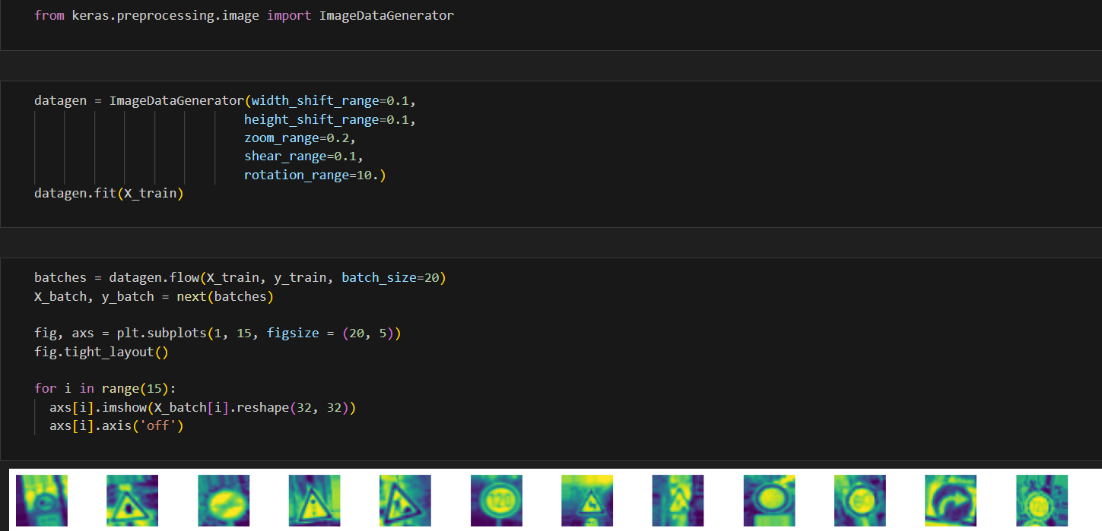

Slide 10
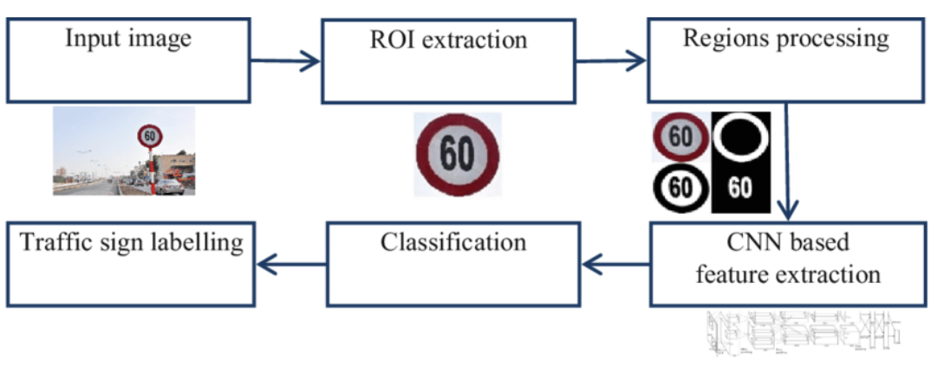
MODELLING

Slide 11
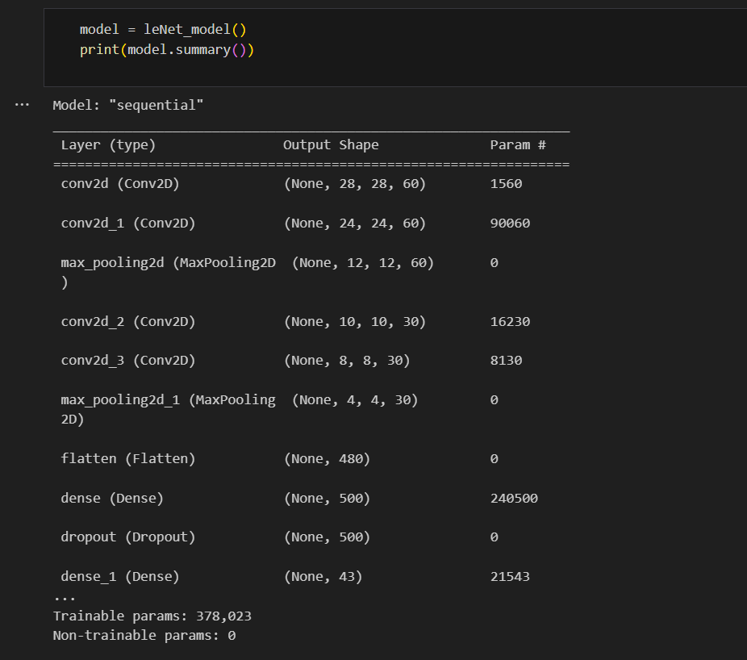

Slide 12
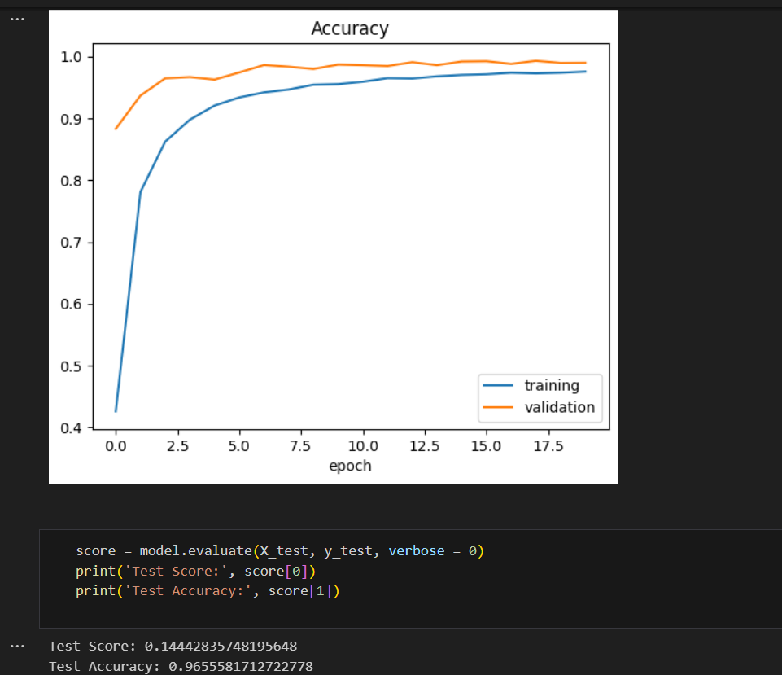
RESULTS

